Slide 1

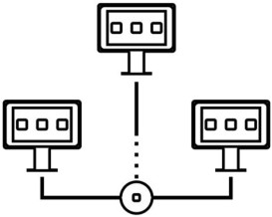



Introduction to
Parallel and Distributed Programming
CS5
Multi-core Programming - PThreads
Sachin D N

Slide 2
Agenda
Lab 3
Problems programming shared memory systems.
Controlling access to a critical section.
Thread synchronisation.
Programming with POSIX threads.
Mutexes.
Producer-consumer synchronisation and semaphores.
Barriers and condition variables.
Read-write locks.
Thread safety.

Slide 3
Lab 3
Enhance performance using multithreading within one node
Use multithreading to improve Lab 2 code on slave nodes. Idea is to improve performance using multiple cores on the same node and show synchronization problems/solutions.

Slide 4


Lab 2: Use cluster to distribute work and do some
parallel data processing
Now that you have a group of nodes managed as a cluster
Create a distributed data processing capability.
Master node takes a dataset and distributes / partitions the data on multiple active slaves that have
enough resources.
Slaves process the data and send results back to Master. Master merges / reduces the data and reports back to the user.
Use blocking vs non-blocking messages in OpenMPI.
Status of the work at slaves is reported back to the master as work progresses and finishes.
Master collects the performance data (CPU, mem, IO) and stores it for analysis.
Any errors are also reported to the master.
Use compression to transfer data. Quantify communication cost - bytes sent over the network,
latency of transfer.
Use OpenMPI for communication between nodes, zlib etc. compression libs
Handle a node crash - Master should get work done on remaining nodes. What are the options - should it restart the job or only shift part of the work to another node ? How is a slave crash detected
? Use the heartbeat mechanism.

Slide 5
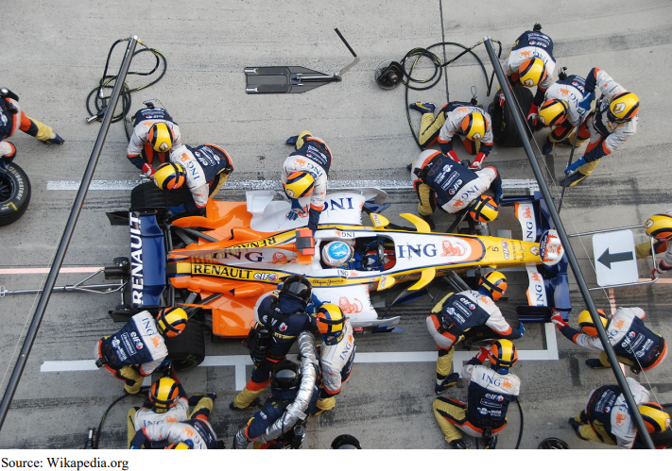
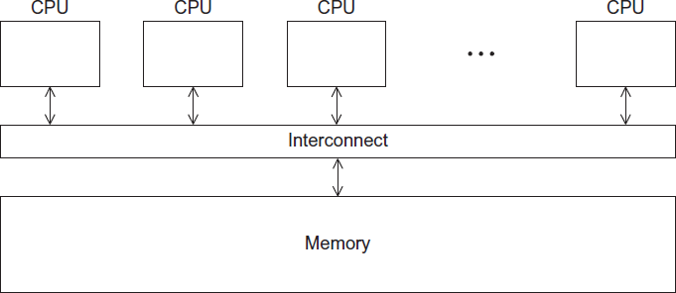

Slide 6


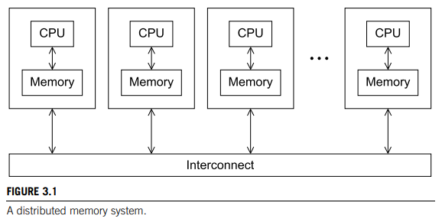

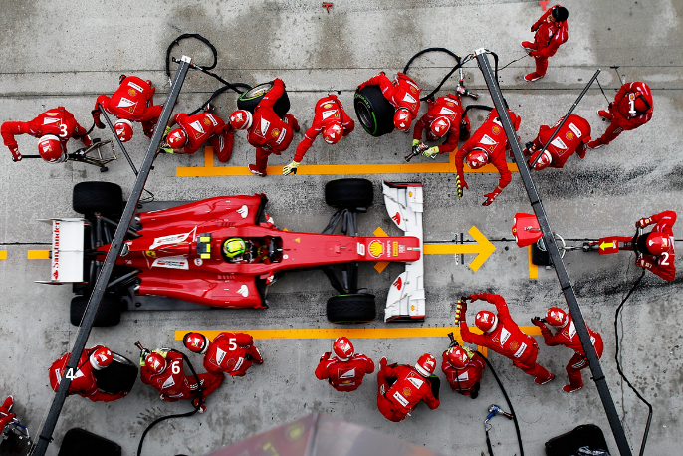

Slide 7
Our Goal and Where we are
Distributed data processing
Parallel and distributed
Programming
Computing
Processing
System

Slide 8
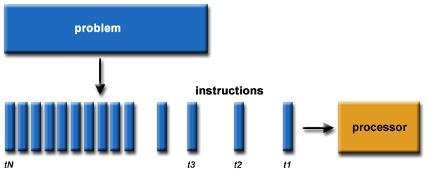

Serial versus Parallel Programming
Notes:
https://researchcomputing.princeton.edu/support/knowledge-base/parallel-code

Slide 9
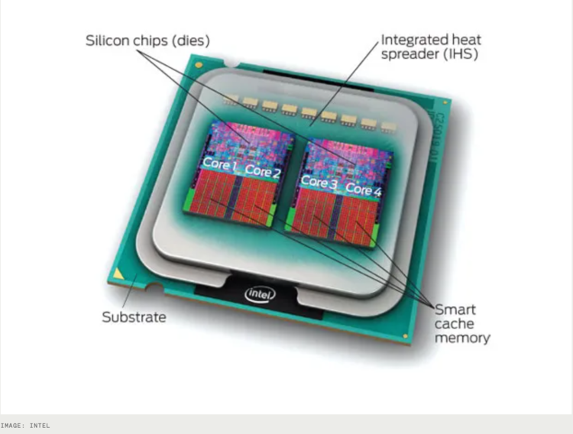
CPU-core – A microprocessing unit on a CPU-chip. Each CPU-core can execute an independent set of instructions from the computer.
GPU – GPU stands for the Graphics Processing Unit. Originally intended to process graphics, in the context of parallel programming this unit can do a large number of simple arithmetic computations.
Memory – In this guide memory refers to Random-Access Memory, or RAM. The RAM unit stores the data that the CPU is actively working on.

Slide 10
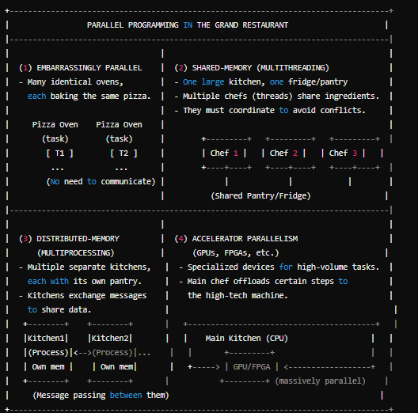


Slide 11

A Shared Memory System

Slide 12
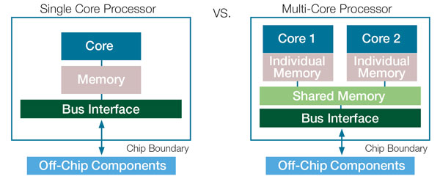
Multicore processors
Multicore processors are a type of central processing unit (CPU) that integrates two or more individual processor cores onto a single chip. Each core in a multicore processor operates independently and can execute its own set of instructions. Multicore processors have become ubiquitous in modern computing devices, ranging from desktop computers to smartphones and embedded systems. Here's an overview of multicore processors:
Key Characteristics:
Multiple Cores:
Multicore processors have two or more individual processor cores on a single chip. Common configurations include dual-core (2 cores), quad-core (4 cores), and octa-core (8 cores), but more cores are also available in high-end processors.
Parallel Processing:
Each core in a multicore processor can execute instructions independently. This allows for parallel processing of tasks, resulting in improved performance and multitasking capabilities.
Shared Resources:
Multicore processors typically share certain resources among the cores, such as the memory subsystem, cache, and input/output interfaces. Efficient management of shared resources is crucial for optimal performance.
Thread Execution:
Multicore processors can execute multiple threads simultaneously. A thread is a sequence of instructions that represents a task or process. Multithreading enables efficient utilization of multiple cores for concurrent execution of threads.

Slide 13
Multicore processors
Advantages:
Improved Performance:
Multicore processors can significantly enhance the performance of computing devices by allowing for parallel execution of tasks. This is particularly beneficial for tasks that can be divided into parallel threads, such as multimedia processing and scientific simulations.
Multitasking:
Multicore processors excel at multitasking. They can handle multiple applications and processes simultaneously without significant performance degradation.
Energy Efficiency:
In many cases, multicore processors can offer better energy efficiency compared to single-core processors. By distributing the workload across multiple cores, each core can operate at lower clock speeds and voltage levels, reducing power consumption.
Scalability:
Multicore processors can be scaled by increasing the number of cores on a chip. This scalability allows manufacturers to meet the performance demands of a wide range of applications and devices.
Challenges:
Parallel Programming:
Taking full advantage of multicore processors requires software that is designed for parallel execution. Parallel programming can be complex, and not all applications can easily be parallelized.
Resource Sharing:
Efficiently managing shared resources like memory and cache among multiple cores can be challenging to ensure optimal performance.
Heat Dissipation:
High-core-count processors can generate a significant amount of heat. Effective cooling solutions are required to maintain thermal stability.
Software Compatibility:
Older software or applications that are not optimized for multicore processors may not fully benefit from the additional cores.

Slide 14
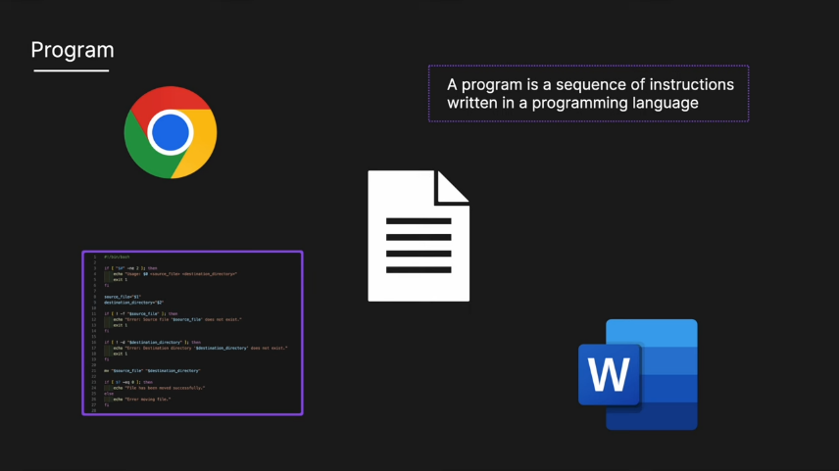
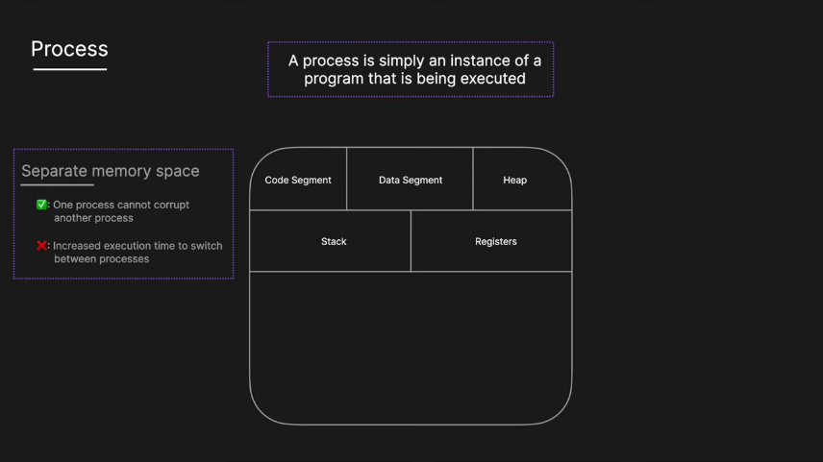
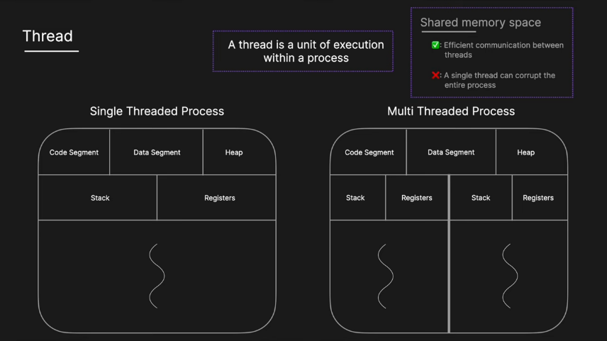
Processes and Threads
A process is an instance of a running (or suspended) program.
Threads are analogous to a “light-weight” process.
In a shared memory program a single process may have multiple threads of control.

Slide 15
POSIX®Threads
Also known as Pthreads.
A standard for Unix-like operating systems.
A library that can be linked with C programs.
Specifies an application programming interface (API) for multi-threaded programming.
The Pthreads API is only available on POSIXR systems — Linux, MacOS X, Solaris, HPUX, …

Slide 16
Why Use Pthreads? (High-Level Motivation)
A thread is like a mini-program running inside a larger program. Instead of running multiple completely separate processes, you can have one program that spawns multiple threads, each doing part of the overall work. Because threads share the same memory space, they can communicate and share data more efficiently than separate processes (which typically must use message passing).
Real-World Example #1 – Web Server:
When a web server receives multiple requests (say from different users), it can spawn a new thread for each incoming request. Each thread then processes the request in parallel, sharing some global information like configuration settings or cached data.
This can be more efficient than starting a whole new process for each request, because processes don’t share memory automatically—they need extra overhead for communication.
Real-World Example #2 – Image Processing:
If you have a large image and want to apply a filter (e.g., a blur or edge detection) in parallel, you can split the image into segments. Each thread processes a segment in memory. Because the threads share the entire image buffer as global data, it’s easy for them to coordinate boundaries between segments without complicated data transfers.
Key Advantages
Shared Data: Threads can see each other’s variables if those variables are declared globally.
Lightweight: Spawning threads is often faster than starting full processes.
Concurrency: Multiple tasks run “simultaneously,” allowing you to take advantage of modern multicore CPUs.

Slide 17
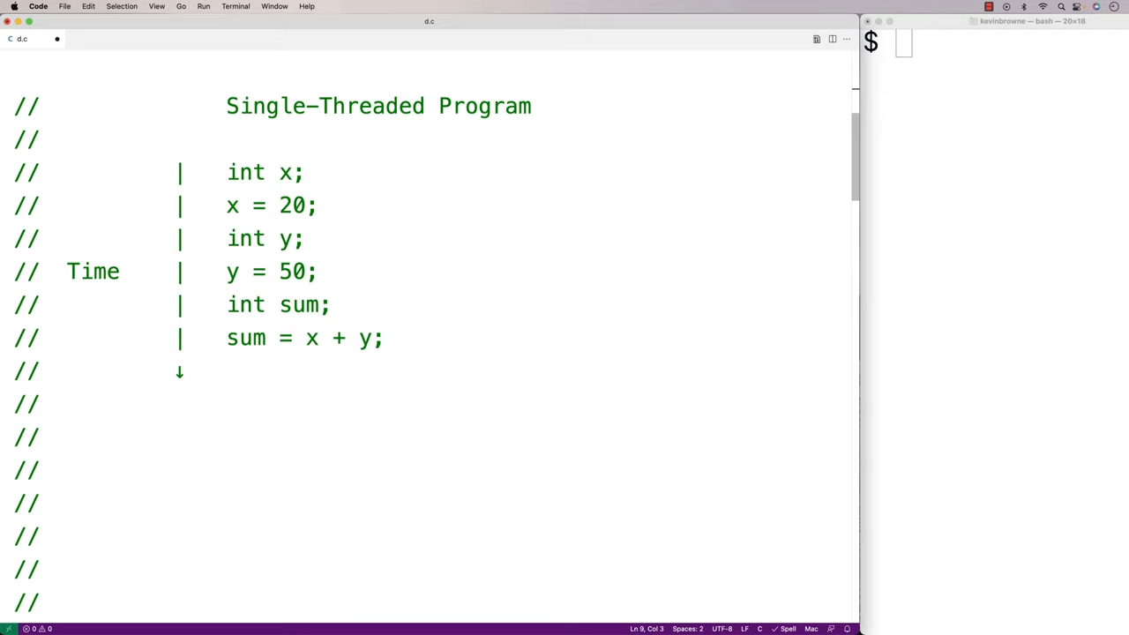
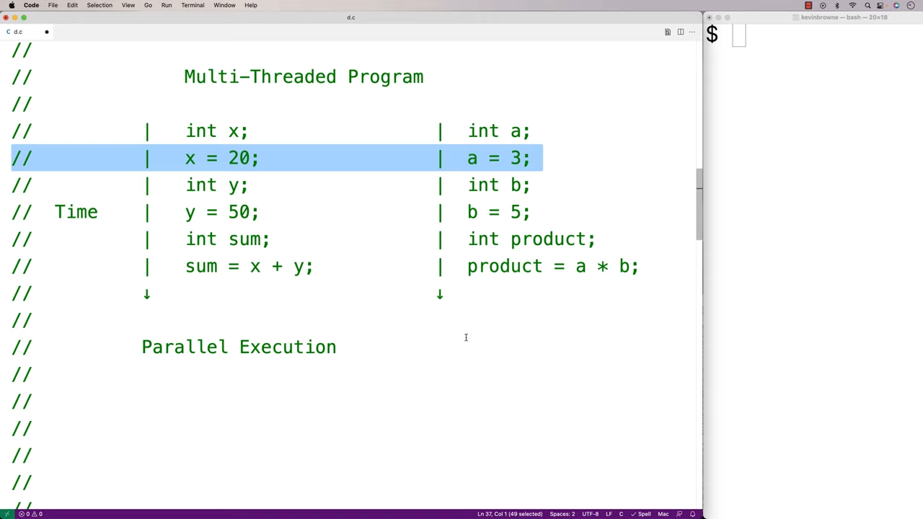
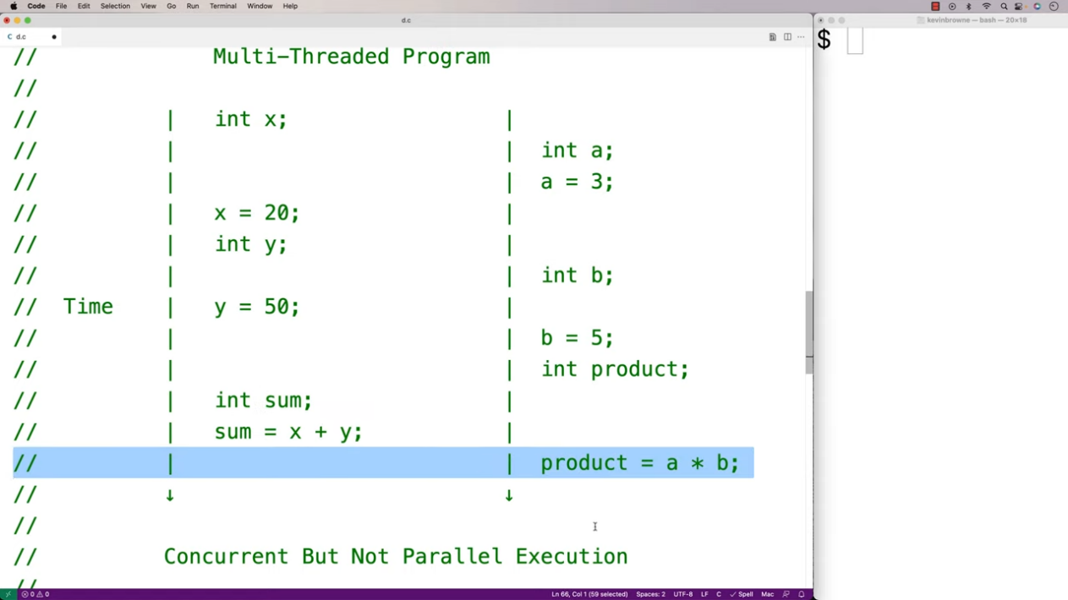
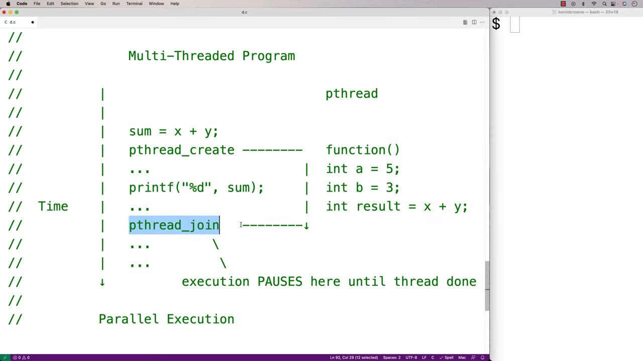

Slide 18
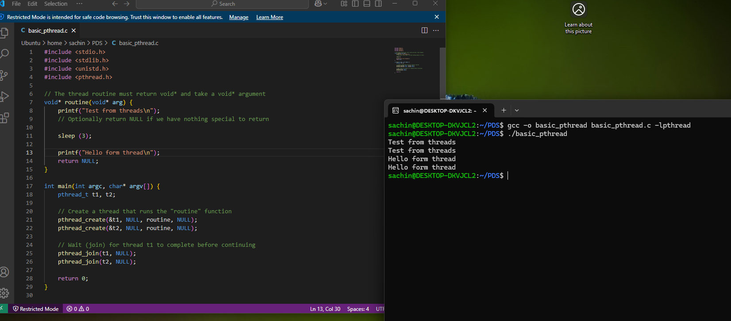

Slide 19
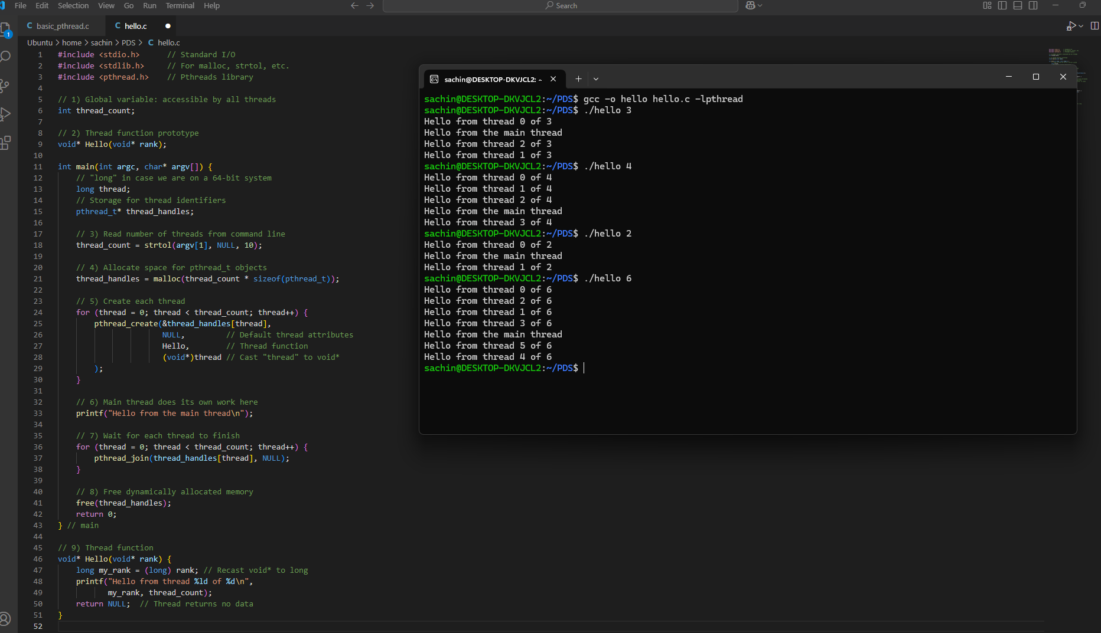
Hello World!

Slide 20
Compiling a Pthread program
gcc -o main main.c -lpthread
./main
link in the Pthreads library

Slide 21
Running a Pthreads program
. / pth_hello <number of threads>
. / pth_hello 1
Hello from the main thread Hello from thread 0 of 1
. / pth_hello 4
Hello from the main thread Hello from thread 0 of 4
Hello from thread 1 of 4
Hello from thread 2 of 4
Hello from thread 3 of 4

Slide 22
Starting the Threads
Processes in MPI are usually started by a script.
In Pthreads the threads are started by the program executable.

Slide 23

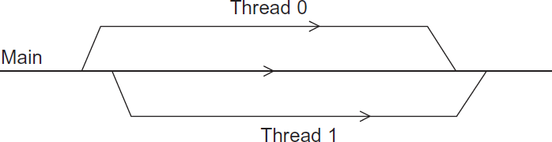



Running the Threads
Main thread forks and joins two threads.

Slide 24
Stopping the Threads
We call the function pthread_join once for each thread.
A single call to pthread_join will wait for the thread associated with the pthread_t object to complete.

Slide 25
Real-World Use Cases
Server Handling Multiple Connections
Scenario: A server application that processes user requests in parallel.
How it works with Pthreads:
The main thread waits for a connection.
Upon receiving a connection (say from a web browser), the main thread creates a new thread to handle all communication with that client.
The newly created thread can access global server configuration (like file paths or database credentials) and process the client’s request.
Once done, the thread either returns or goes into a “thread pool” of reusable threads.
Numerical Simulations / Data Analysis
Scenario: You have a large dataset and a mathematical simulation that needs to iterate over each data point.
Example: Climate modeling, where each thread processes a portion of a 2D or 3D grid (temperature, pressure, etc.).
How it works with Pthreads:
Global variables might store the entire simulation grid.
Each thread is assigned a subset of the grid (e.g., rows 100–199).
They all run the same function, but use their “rank” to figure out which part of the data to process.

Slide 26
Real-World Use Cases
4.3 Real-Time Video Processing
Scenario: A security system analyzing video frames for anomalies (like motion detection).
How it works with Pthreads:
A main capture loop obtains new video frames.
Each new frame spawns a thread that processes it (detecting edges, shapes, or movement).
Several frames might be processed in parallel if the camera feed is fast.
The threads share certain global settings (e.g., detection thresholds, region-of-interest masks).
4.4 UI Applications / Games
Scenario: A graphical application (like a game) where one thread handles rendering while another handles AI logic or user input.
How it works with Pthreads:
The rendering thread continuously updates the screen.
Another thread reads user inputs (mouse, keyboard) and updates global state.
Yet another thread might handle the game physics.
All these threads share data structures but must synchronize to avoid conflicts.

Slide 27
Thread Lifecycle & Design Patterns
Fork-Join Approach
Used in the example program:
Fork (spawn): Main thread creates a batch of worker threads.
Join (wait): Main thread blocks until each worker finishes, then the program ends.
This approach is common for short, fixed-size tasks—like a known number of tasks to be completed in one shot.
“Thread Pool” / “Workers on Demand”
For servers or applications with indefinite workload, you might not want to create and destroy threads repeatedly. Instead:
Pre-create a pool of threads.
Each incoming task (e.g., request or job) is assigned to an available (idle) thread from the pool.
When the thread finishes, it signals it’s ready for the next task.
This pattern helps reduce overhead caused by constantly creating and destroying threads.
On-the-Fly Thread Creation
The “Web server” style approach: The main thread continuously runs, and each time a request arrives, it spins up a new thread if needed

Slide 28
Potential Pitfalls & Best Practices
Shared Data Conflicts (Race Conditions)
Since all threads in Pthreads share global variables, two threads may try to modify the same variable simultaneously, causing unpredictable results (a “race condition”).
Solution: Use synchronization constructs (mutexes, semaphores, condition variables) to lock shared data while one thread updates it.
Zombie Threads
If we create threads but never call pthread_join or pthread_detach, you waste system resources. The thread is done executing but is still occupying an internal structure in the OS.
Always join or detach your threads when they are finished.
Too Many Threads
Creating thousands of threads can lead to overhead or resource exhaustion. You usually want fewer threads than or around the same magnitude as the number of CPU cores, especially for CPU-bound tasks.
Global Variables vs. Local Variables
Overuse of global variables can cause debugging nightmares.
Try to give threads local copies of data or pass them references to specific areas of memory they need to update.
Memory Management
If you dynamically allocate structures for each thread (like in malloc), ensure you free them after you’re done. This is especially important in long-running applications.

Slide 29
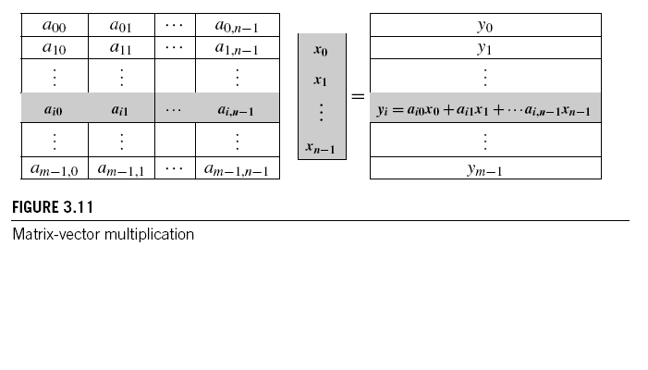



Matrix-Vector Multiplication in pthreads

Slide 30
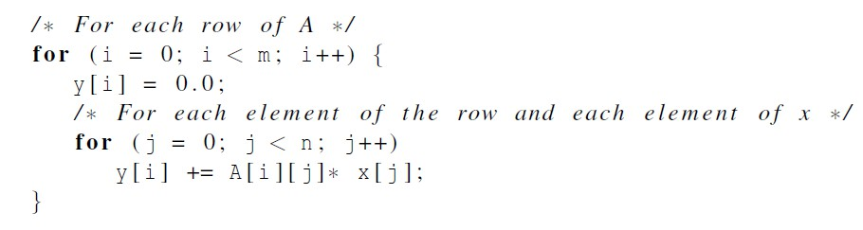

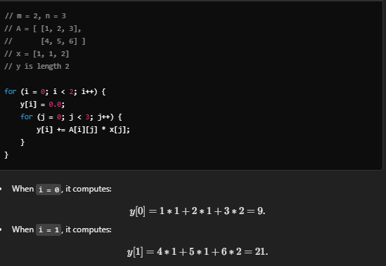
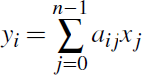
Serial pseudo-code

Slide 31
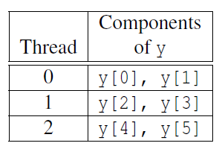
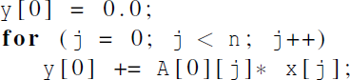

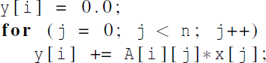
Using 3 Pthreads
thread 0
general case

Slide 32
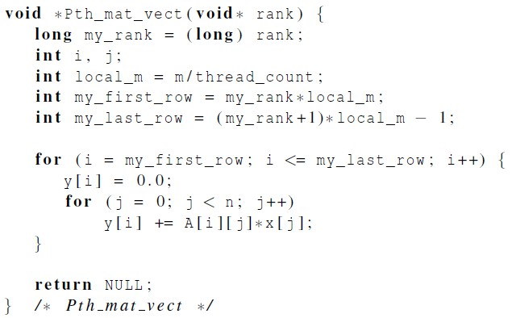




Pthreads matrix-vector multiplication

Slide 33
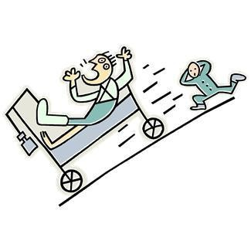
Critical sections
A critical section is a piece of code that accesses and modifies shared data. If multiple threads can execute that code at the same time, the data might become inconsistent or produce unpredictable results—a scenario called a race condition.
Race Condition Example: Two threads both want to update a shared variable. If Thread A reads the variable and then Thread B reads the variable (before A’s update is stored), one thread’s update may overwrite the other’s. Hence the final value depends on the timing, not just the logic.
Key Point
We must ensure that only one thread at a time can execute the critical section that modifies (or sometimes even reads) a shared resource if consistency is at risk. This is usually done with synchronization mechanisms like mutexes (mutual exclusion locks).

Slide 34

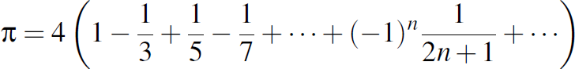
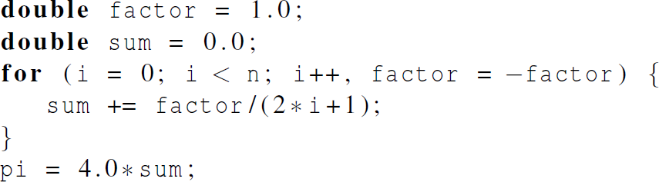

Estimating π

Slide 35
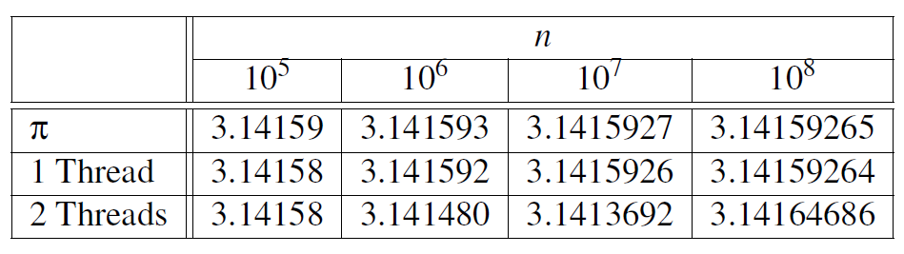
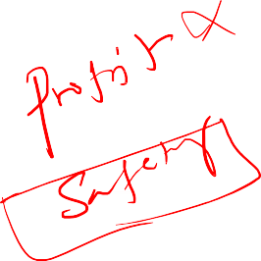
Using a dual core processor
Note that as we increase n, the estimate with one thread gets better and better.

Slide 36
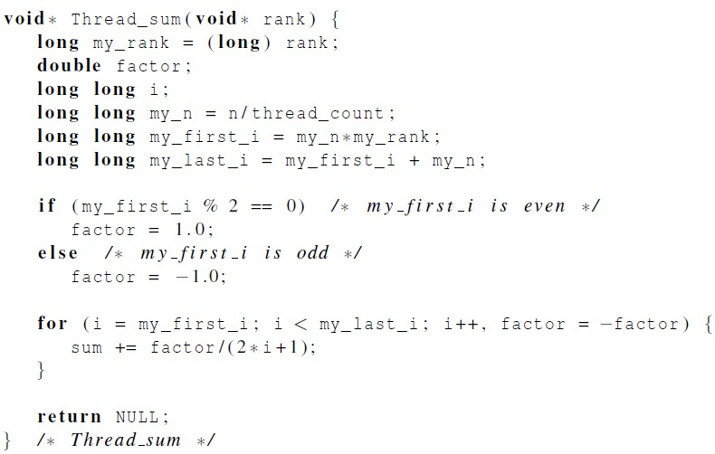



A thread function for computing π

Slide 37
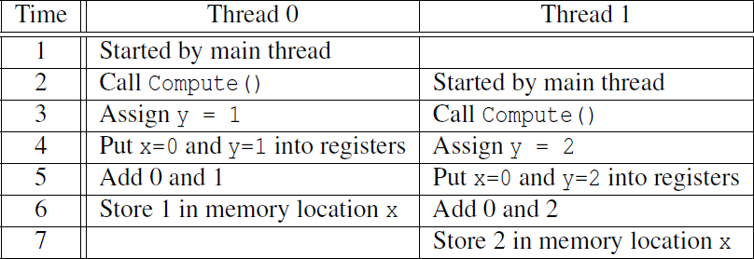




Possible race condition

Slide 38




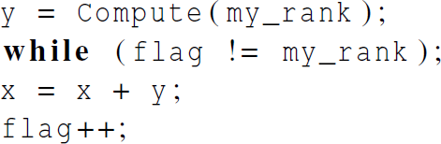
Busy-Waiting
A thread repeatedly tests a condition, but, effectively, does no useful work until the condition has the appropriate value.
Beware of optimizing compilers, though!
flag initialized to 0 by main thread

Slide 39
Pthreads global sum with busy-waiting
Initialization: y = Compute(my_rank);
Each thread computes its own value of y based on its rank (thread ID).
Busy-Wait Loop: while (flag != my_rank);
This line ensures that a thread will only proceed if the flag variable matches its rank.
If the condition is not met, the thread keeps checking the condition in a loop without doing any other work. This is the busy-waiting part.
Critical Section: x = x + y;
Once the thread passes the busy-wait loop, it enters the critical section and performs the operation x = x + y;.
Update Flag: flag++;
After the critical section is executed, the thread increments the flag so that the next thread can enter the critical section.

Slide 40
Busy-Wait Loop in Action
Suppose the main thread initializes flag to 0.
If thread 1 completes its computation (y = Compute(my_rank);) before thread 0, it will encounter the while loop and keep checking while (flag != my_rank); until flag becomes 1.
Thread 0, on the other hand, will pass the while loop because flag is initially 0, and it proceeds to the critical section x = x + y;.
After thread 0 finishes its critical section, it increments flag++ (so now flag becomes 1), allowing thread 1 to proceed.

Slide 41
Key Points – Busy Waiting
Busy-Waiting: While thread 1 waits for flag to become 1, it constantly checks the condition, using CPU resources inefficiently.
Compiler Optimization: The busy-wait solution assumes that statements are executed as written. If compiler optimizations are enabled, the order of statements might change, leading to incorrect results.
Performance: Busy-waiting, also known as a spinlock, can degrade performance, especially if one thread is delayed or preempted by the operating system.
Busy-waiting ensures exclusive access to critical sections, but it's not an ideal solution due to its inefficiency and potential for performance degradation. There are better synchronization mechanisms, such as mutexes and semaphores, that avoid busy-waiting and provide more efficient ways to manage access to shared resources.

